Slide 1
Maximum Flow

Slide 2
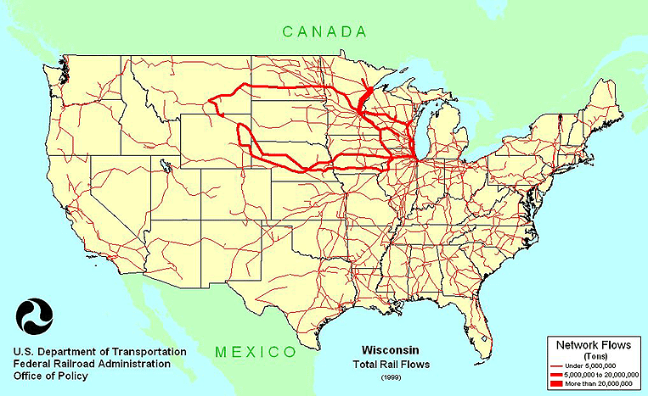
Network Flows

Slide 3
Types of Networks
Internet
Telephone
Cell
Highways
Rail
Electrical Power
Water
Sewer
Gas
…

Slide 4
Maximum Flow Problem
How can we maximize the flow in a network from a source or set of sources to a destination or set of destinations?
The problem reportedly rose to prominence in relation to the rail networks of the Soviet Union, during the 1950's. The US wanted to know how quickly the Soviet Union could get supplies through its rail network to its satellite states in Eastern Europe.
In addition, the US wanted to know which rails it could destroy most easily to cut off the satellite states from the rest of the Soviet Union. It turned out that these two problems were closely related, and that solving the max flow problem also solves the min cut problem of figuring out the cheapest way to cut off the Soviet Union from its satellites.
Source: lbackstrom, The Importance of Algorithms, at www.topcoder.com

Slide 5
Network Flow
Instance:
A Network is a directed graph G
Edges represent pipes that carry flow
Each edge (u,v) has a maximum capacity c(u,v)
A source node s in which flow arrives
A sink node t out which flow leaves
Goal: Max Flow
Figure courtesy of J. Edmonds

Slide 6
The Problem
Use a graph to model material that flows through conduits.
Each edge represents one conduit, and has a capacity, which is an upper bound on the flow rate, in units/time.
Can think of edges as pipes of different sizes.
Want to compute max rate that we can ship material from a designated source to a designated sink.

Slide 7
What is a Flow Network?
Each edge (u,v) has a nonnegative capacity c(u,v).
If (u,v) is not in E, assume c(u,v)=0.
We have a source s, and a sink t.
Assume that every vertex v in V is on some path from s to t.
e.g., c(s,v₁)=16; c(v₁,s)=0; c(v₂,v₃)=0

Slide 8
What is a Flow in a Network?
For each edge (u,v), the flow f(u,v) is a real-valued function that must satisfy 3 conditions:
Notes:
The skew symmetry condition implies that f(u,u)=0.
We show only the positive flows in the flow network.

Slide 9
Example of a Flow:
capacity
flow
capacity
f(v₂, v₁) = 1, c(v₂, v₁) = 4.
f(v₁, v₂) = -1, c(v₁, v₂) = 10.
f(v₃, s) + f(v₃, v₁) + f(v₃, v₂) + f(v₃, v₄) + f(v₃, t) =
0 + (-12) + 4 + (-7) + 15 = 0

Slide 10
The Value of a flow
The value of a flow is given by
This is the total flow leaving s = the total flow arriving in t.

Slide 11
Example:
|f| = f(s, v₁) + f(s, v₂) + f(s, v₃) + f(s, v₄) + f(s, t) =
11 + 8 + 0 + 0 + 0 = 19
|f|= f(s, t) + f(v₁, t) + f(v₂, t) + f(v₃, t) + f(v₄, t) =
0 + 0 + 0 + 15 + 4 = 19

Slide 12
A flow in a network
We assume that there is only flow in one direction at a time.
Sending 7 trucks from Edmonton to Calgary and 3 trucks from Calgary to Edmonton has the same net effect as sending 4 trucks from Edmonton to Calgary.

Slide 13
Residual Networks
The residual capacity of an edge (u,v) in a network with a flow f is given by:
The residual network of a graph G induced by a flow f is the graph including only the edges with positive residual capacity, i.e.,

Slide 14
Example of Residual Network
Flow Network:
Residual Network:

Slide 15
Augmenting Paths ( A Useful Concept )
Definition:
An augmenting path p is a simple path from s to t on a residual network
that is an alternating sequence of vertices and edges of the form
s,e₁,v₁,e₂,v₂,...,e_{k},t in which no vertex is repeated and no forward edge
is saturated and no backward edge is free.
Characteristics of augmenting paths:
We can put more flow from s to t through p.
The edges of residual network are the edges on which residual capacity
is positive.
We call the maximum capacity by which we can increase the flow on p
the residual capacity of p.

Slide 16
Augmenting Paths
Network:
Residual Network:
Augmenting path
The residual capacity of this augmenting path is 4.

Slide 17
Computing Max Flow
Classic Method:
Identify augmenting path
Increase flow along that path
Repeat

Slide 18
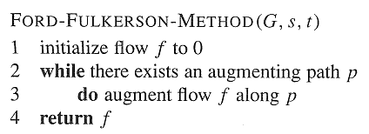
Ford-Fulkerson Method

Slide 19
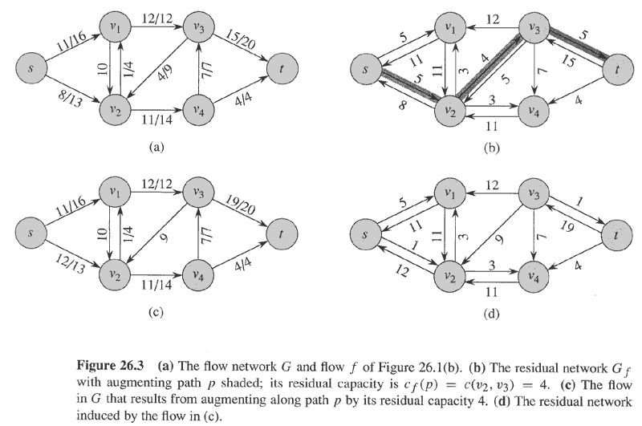
Example
Flow(1)
Residual(1)
No more augmenting paths → max flow attained.
Flow(2)
Residual(2)
Cut

Slide 20
Cuts of Flow Networks

Slide 21
The Net Flow through a Cut (S,T)
f(S,T) = 12 – 4 + 11 = 19

Slide 22
The Capacity of a Cut (S,T)
c(S,T)= 12+ 0 + 14 = 26

Slide 23
Augmenting Paths – example
Capacity of the cut
= maximum possible flow through the cut
= 12 + 7 + 4 = 23
Flow(2)
cut
The network has a capacity of at most 23.
In this case, the network does have a capacity of 23, because this is a minimum cut.

Slide 24
Net Flow of a Network
The net flow across any cut is the same and equal to the flow of the network |f|.

Slide 25
Bounding the Network Flow
The value of any flow f in a flow network G is bounded from above by the capacity of any cut of G.

Slide 26
Max-Flow Min-Cut Theorem
If f is a flow in a flow network G=(V,E), with source s and sink t, then the following conditions are equivalent:
f is a maximum flow in G.
The residual network G_{f} contains no augmented paths.
|f| = c(S,T) for some cut (S,T) (a min-cut).

Slide 27
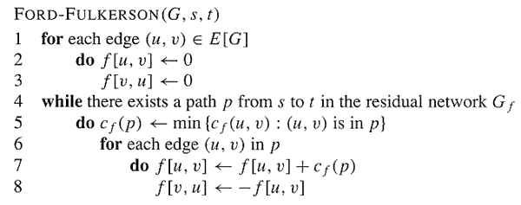
The Basic Ford-Fulkerson Algorithm

Slide 28
Example
augmenting path
Original Network
Flow Network
Resulting Flow =
4

Slide 29
Example
Resulting Flow =
Flow Network
4
augmenting path
Residual Network
Flow Network
Resulting Flow =
11

Slide 30
Example
Flow Network
Resulting Flow =
11
augmenting path
Residual Network
Flow Network
Resulting Flow =
19

Slide 31
Example
Flow Network
Resulting Flow =
19
augmenting path
Residual Network
Flow Network
Resulting Flow =
23

Slide 32
Example
Resulting Flow =
23
No augmenting path:
Maxflow=23
Residual Network

Slide 33
Analysis
O(E)
?
O(E)

Slide 34
Analysis
If capacities are all integer, then each augmenting path raises |f| by ≥ 1.
If max flow is f*, then need ≤ |f*| iterations → time is O(E|f*|).
Note that this running time depends on |f*|, which is not a function of |V| or |E|.
If capacities are rational, can scale them to integers.
If irrational, FORD-FULKERSON might never terminate!

